Slide 1
BARC Tube Bending Week 5

Slide 2
Checklist
Process: Manual Edge detection Smoothing edges Fitting lines to straight sections Angle Calculation Part 1 ( Bends 1 & 2) Part 2 ( Bends 2,3 & 4) Automated Edge detection Smoothing edges Fitting lines to straight sections Angle Calculation Part 1 ( Bends 1 & 2) Part 2 ( Bends 2,3 & 4) | Varying Parameters: Background Color Background Brightness Distance to LED box Height of camera Camera Orientation Lighting (Front vs Back) Different cameras/lenses Adding noise (non-ideal lighting conditions) No. of Cameras

Slide 3
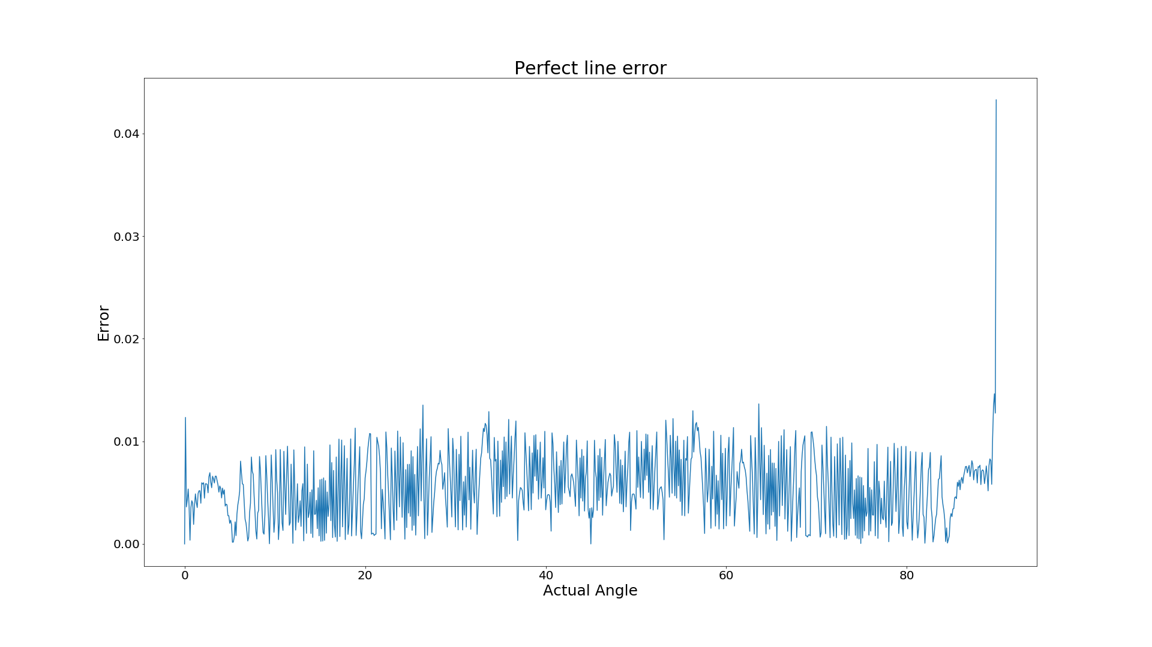
Last Week Result: Higher Resolution Error
The number of pixels in the bending part is approx. 500px.
Increase resolution to 4K, number of pixels to 1000px.
Observation: Higher resolution leads to smaller angle error

Slide 4
Current Week Effort
Angle Error Plot Trend
Obtain a plot of angle error on increasing the number of pixels in an ideal straight line
Gain insights on resolution of image, maximum error and mean error from the plot
Angle Calculation using in-built function
Use houghlines function that uses hough line transform to fit straight lines to the edges
Choose lines that have fit “well” and calculate angles

Slide 5
Current Week Effort
Varying Camera distance
Change the camera distance, calibrate and capture image of sample
Find angle error using Houghlines and polyfit functions
Compare with error for default camera-sample distance

Slide 6
1.1 Angle Error Plot Trend: Procedure
We drew two straight sections at angles varying from 0 - 45 degrees using OpenCV and fit straight lines to these sections. Each of these sections was made up of a fixed number of pixels
We then calculated the angle between the fitted straight lines and compared it with the true angle between the drawn sections
Finally we increased the number of pixels in these straight sections and repeated the above two steps

Slide 7
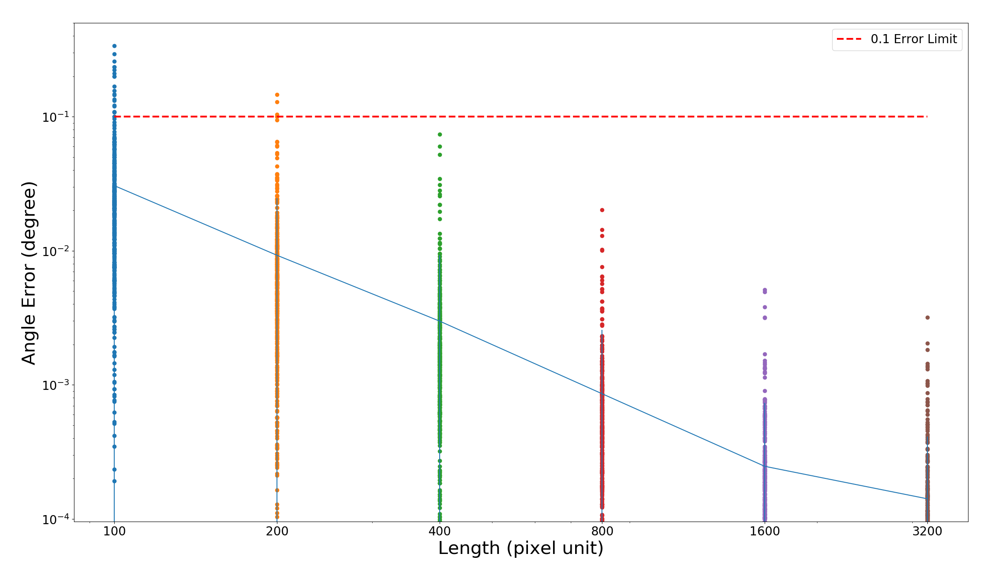
1.2 Angle Error Plot Trend: Plot
Information obtained:
Angle error for 0-45
Mean error
Deviation

Slide 8
1.3 Angle Error Plot Trend: Insights
General decreasing error trend as the pixel length increases
For pixel lengths of the order of 10^3 and higher, the error is close to 0.001 (required: 0.05-0.1)
This substantiates our assumption that a camera with higher resolution will lead to more precision in angle calculation

Slide 9
2.1 Using Houghline function: Procedure
MATLAB’s in-built houghlines function used
Function fits straight lines using hough transform
The line fitting depends on:
Distance between pixels
Number of pixels
Alter Threshold factor to change fit of lines on the edges

Slide 10
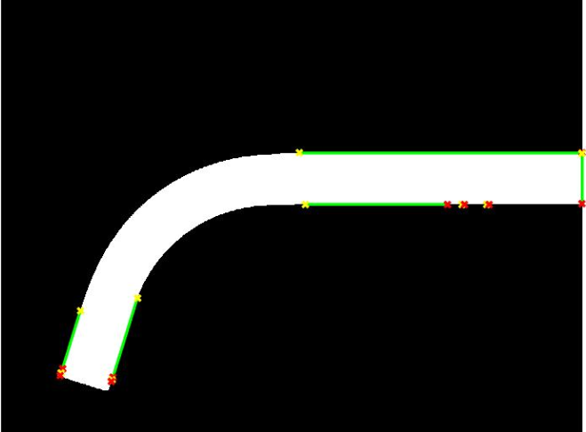
2.2 Using Houghline function: 0.1 factor
Threshold factor = 0.1
Angle error right edge = 0.0981
Angle error left edge = 0.1284

Slide 11
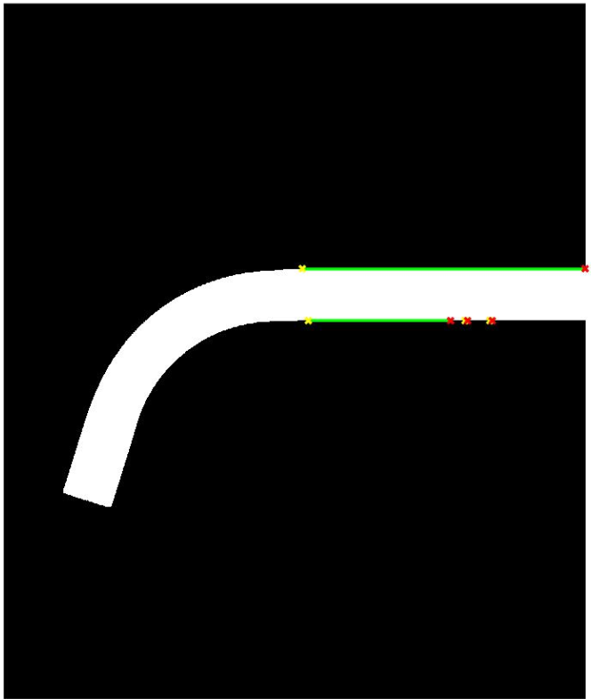
2.3 Using Houghline function: 0.3 factor
Threshold factor = 0.3
Houghlines does not draw a line in the slant section

Slide 12
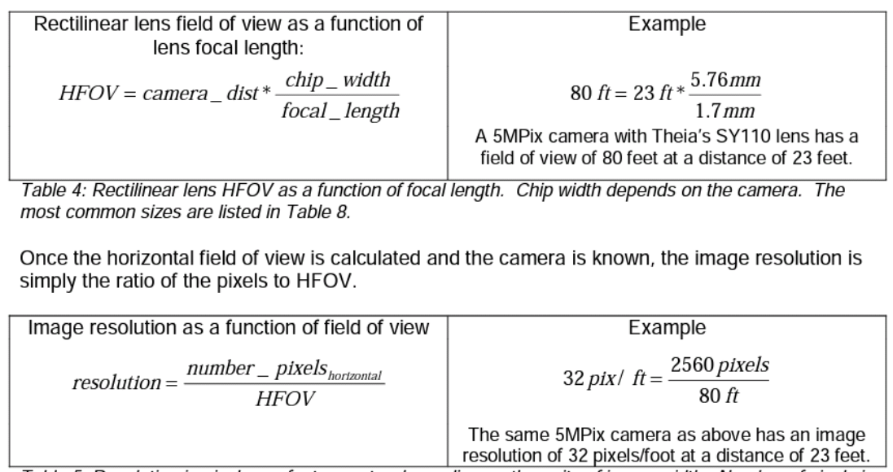
Calculating Resolution

Slide 13
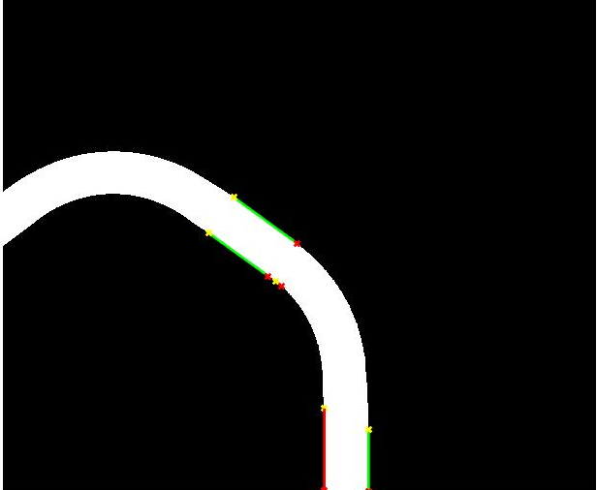
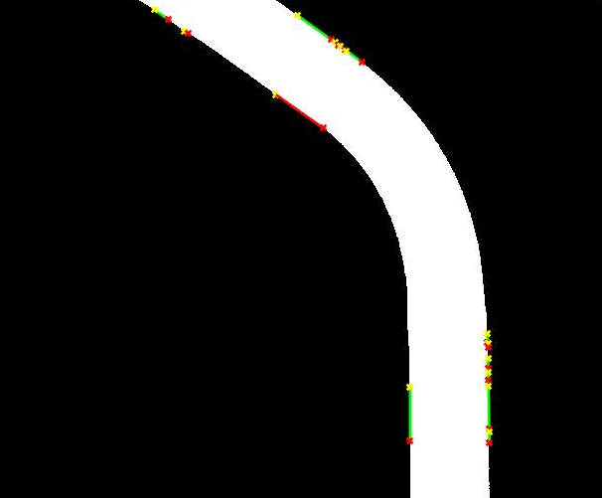
3. Angle Error Comparison - Varying Distance
Observation Distance: 33.5 in Angle error = 0.6162 Resolution = 634.328 Px/in | Observation Distance: 21 in Angle error = 0.0361 degrees Resolution = 1011.9 Px/in
Observation:
Closer distance
More pixels per length
Lesser angle error

Slide 14
Future Work
Make the houghlines algorithm robust, (sometimes it misses certain straight sections)
Houghlines fits many straight lines to the straight sections, we need to automate choosing the lines that will give most accurate measure of bend angle.
Take images of bend from different heights and calculate bend angle from the images. Obtain a relation to find the minimum no. of pixels needed to get below the error threshold as a function of tube length and height of camera.

